Slide 1

ORACLE RESPONSIBILITY PROVISIONING AUTOMATION
By Shubham Gupta

Slide 2
What is FireEye?
The pioneer in next-generation threat protection to combat cyber attacks
Cyber security products combat advanced persistent threats (APTs).
State-of-the-art network security products protect against cyber attacks
Expertise in malware analysis.
Efficient response time during attacks.
Notes:
APT :- Stay in the host system for a long time.
Specialize in malware analysis.
bypass traditional signature-based tools such as antivirus software, next-generation firewalls, and sandbox tools.
Focus on malware and not virus. Virus will become outdated. Malware can stay in the system for days undetected.
Median response time :- 32 days. FE Response time :- Reduced to a couple of minutes.

Slide 3

How do we do it?
RESPOND ANALYZE
DETECT PREVENT
DETECT
PREVENT
SIGNATURE-LESS AND MULTI FLOW VIRTUAL MACHINE BASED APPROACH THAT LEVERAGES SUPERIOR THREAT INTELLIGENCE
MULTI-VECTOR INLINE KNOWN AND UNKNOWN THREAT PREVENTION
RESPOND
ANALYZE
REMEDIATION SUPPORT AND THREAT INTELLIGENCE TO RECOVER AND IMPROVE RISK POSTURE
CONTAINMENT, FORENSICS INVESTIGATION AND KILL CHAIN RECONSTRUCTION
Notes:
Fireeye tracks malware callbacks. Execute the files in a VM stored on the device which then check for the callback(info being sent back to the cloud)
multi-flow Multi-Vector Virtual Execution (MVX) engine. The MVX engine captures and confirms zero-day, and targeted APT attacks by detonating suspicious files, Web objects, and email attachments within instrumented virtual machine environments.

Slide 4
Major Products
-NX Series (wMPS):- Network Security
-EX Series (eMPS):- Email Security
-Dynamic Threat Intelligence (DTI):- Swift analysis and reports
-FaaS(FireEye as a Service)
Notes:
NX :- Used to check incoming packets/data for malware.
EX :- Email Threat Prevention:- Web security to detect and block malicious files, communication channels, and exploit attempts. Faster Response. Used to block phishing attempts
DTI :- enables cyber security teams to effectively identify, block, analyze and respond to advanced cyber attacks. Anonymously exchange data.
FaaS :- FireEye professionals also help.Help in detecting early signs of attacks.

Slide 5
What is ISS?
Information Systems and Services
Support the business.
Deployed various enhancements and NPI’s.
Maintain the FireEye Website. 50-60k visitors everyday
ORACLE
SFDC
WORKDAY
BI
INTEGRATION
LMS
SHAREPOINT
WEB
QA
Notes:
FireEye website. Used by potential clients to get info

Slide 6
PROJECT OVERVIEW
An Access Management platform allows users of Oracle Application to gain access to required roles.
Framework to Speed the provisioning process.
Current process→ Manual and laborious.
Service request needs to created for each request and tracking is needed by the Oracle Support Team.
Enables SOX compliance by tracking the provision audit.
Notes:
Responsibilities: Privileges or certain rights given to an individual which enable them to perform required functions.
Creation of a service request for every request. Needs to be tracked by the oracle support team.
Sarabanes Oxley Compliance. Helps in tracking why the request was created and why the request was granted.

Slide 7
NEED AND ARCHITECTURE
Concrete structure
Automatic and quick
Control and monitoring
Prevent unauthorized access
No service request created
Frontend
Oracle Applications OAF Page
Backend
Oracle Workflow, Oracle Databases
AOL, Java, SQL, PL/SQL

Slide 8
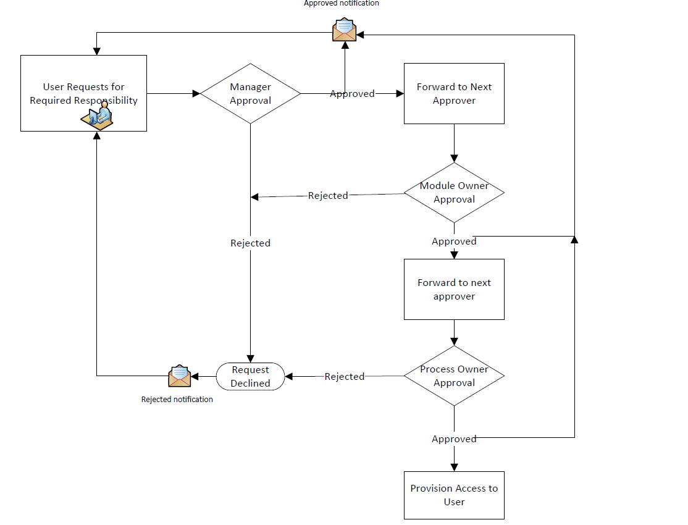
WorkFlow
Notes:
User will select and request the responsibility
2 levels :- Manager
Sublevel :- Module(Primary) and Process(Secondary)
If Module owners don’t respond for 2 days, request forwarded to process owners.
Rejection at any point leads to no assignment of responsibilities.
All notifications send via Email. Makes the process smooth and more user friendly.

Slide 9
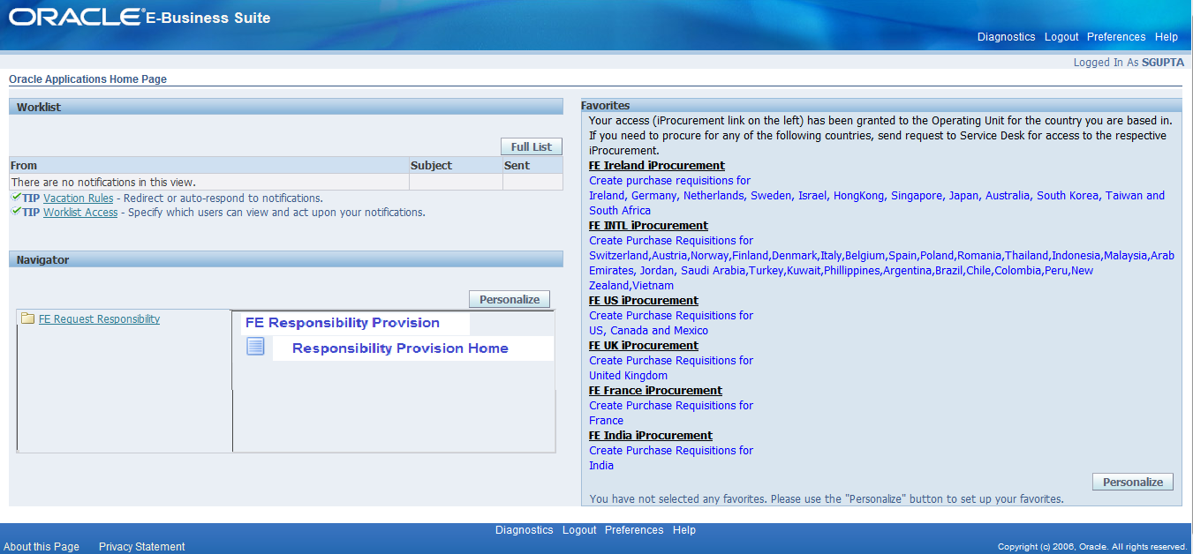
IMPLEMENTATION
Default assignment of ‘FE Responsibility Provision’ responsibility.
Users can search for the required responsibility and request for it.

Slide 10
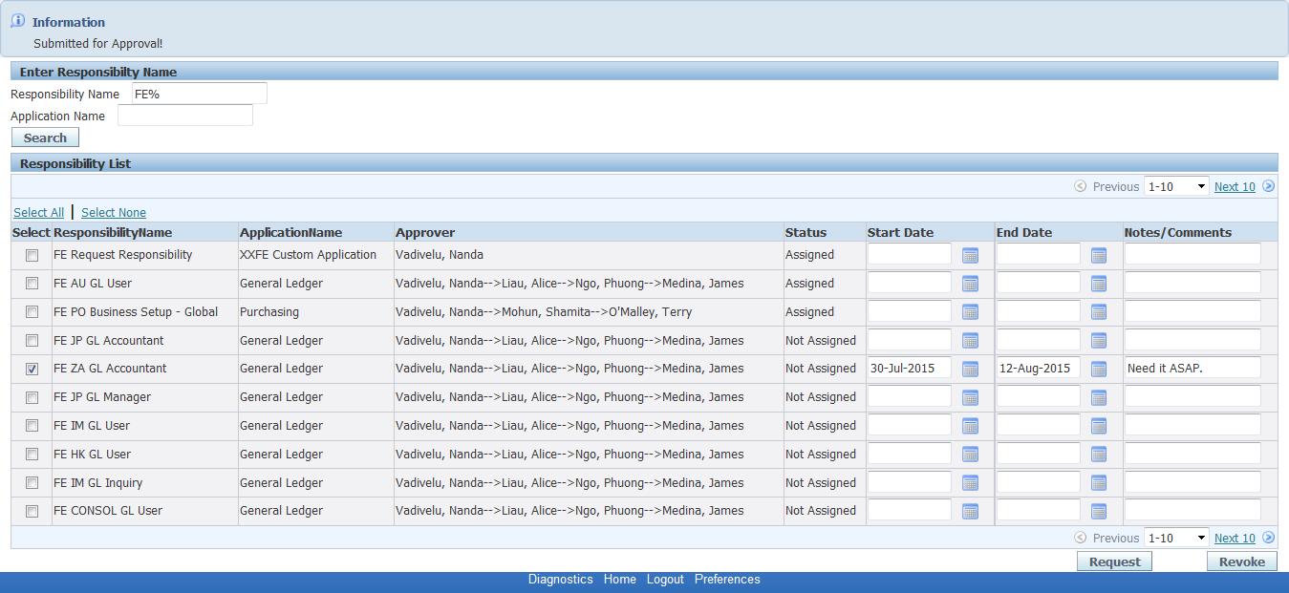
REQUEST PAGE
Notes:
Cant’ request for a currently assigned responsibility.
Can’t request for a responsibility that is currently in approval process.
Can’t revoke a responsibility that isn’t assigned to the user.

Slide 11
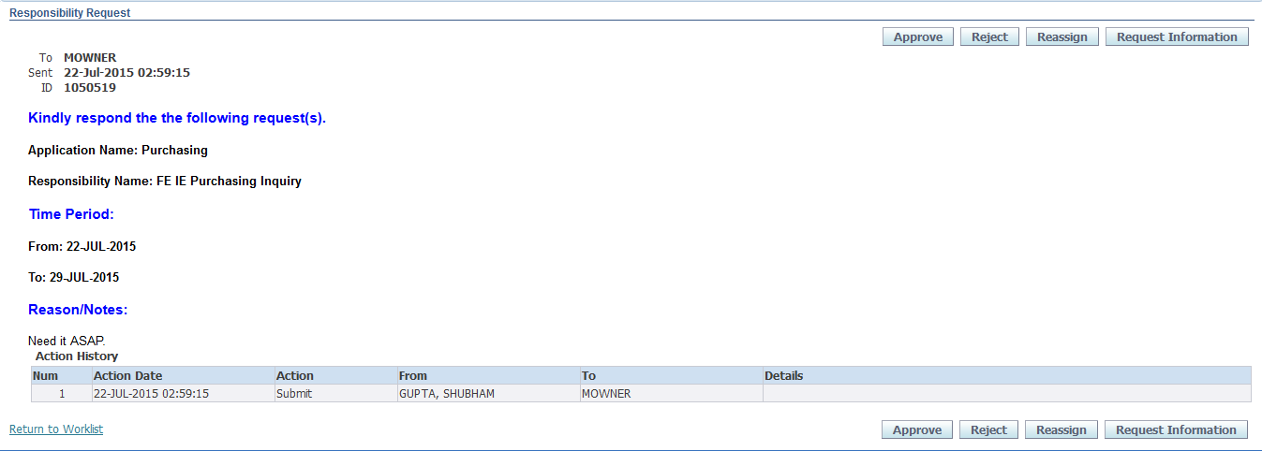
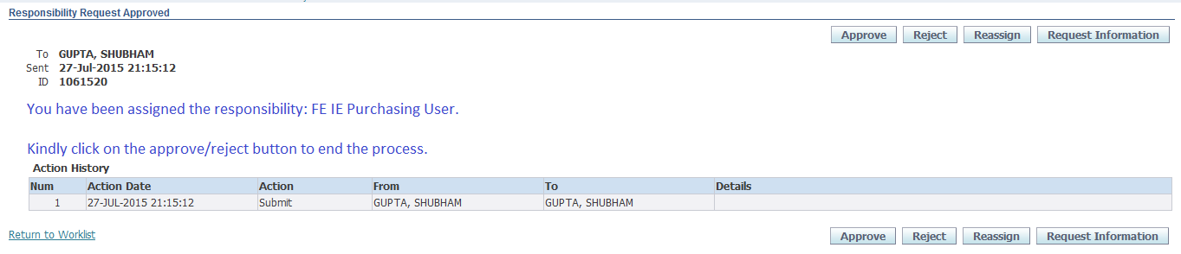
NOTIFICATION

Slide 12
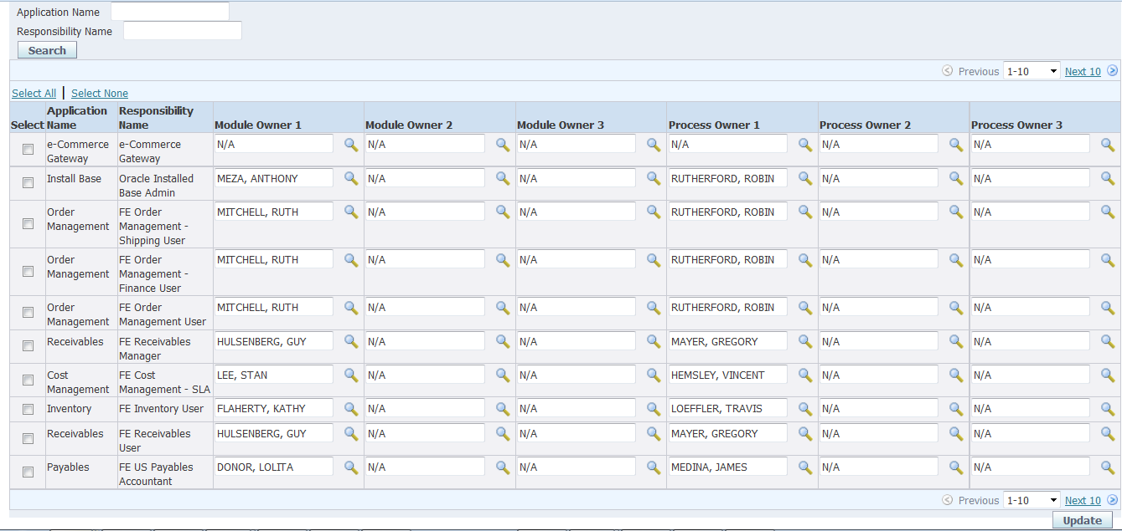
APPROVERS PAGE
Notes:
Assuming the approvers change over time, Created a page for approvers.
Page accessible only to the oracle support team.
Can edit/ add approvers.

Slide 13
THANK YOU

